Slide 1

Underdog Fantasy 'The Dinger' Analysis
By: Nate Besold

Slide 2
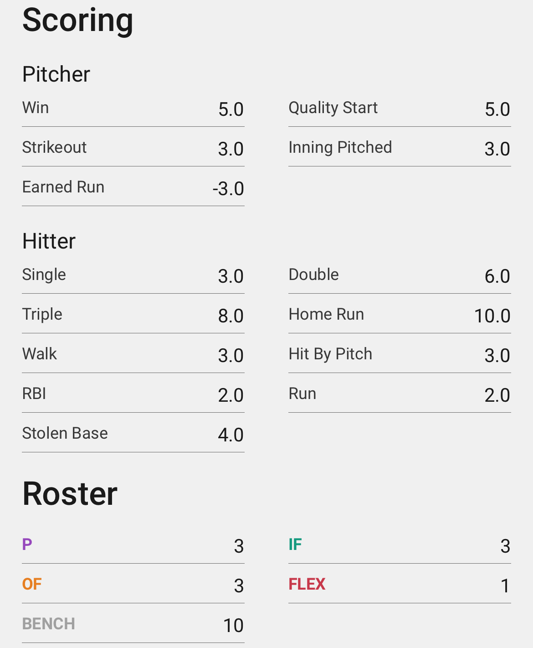
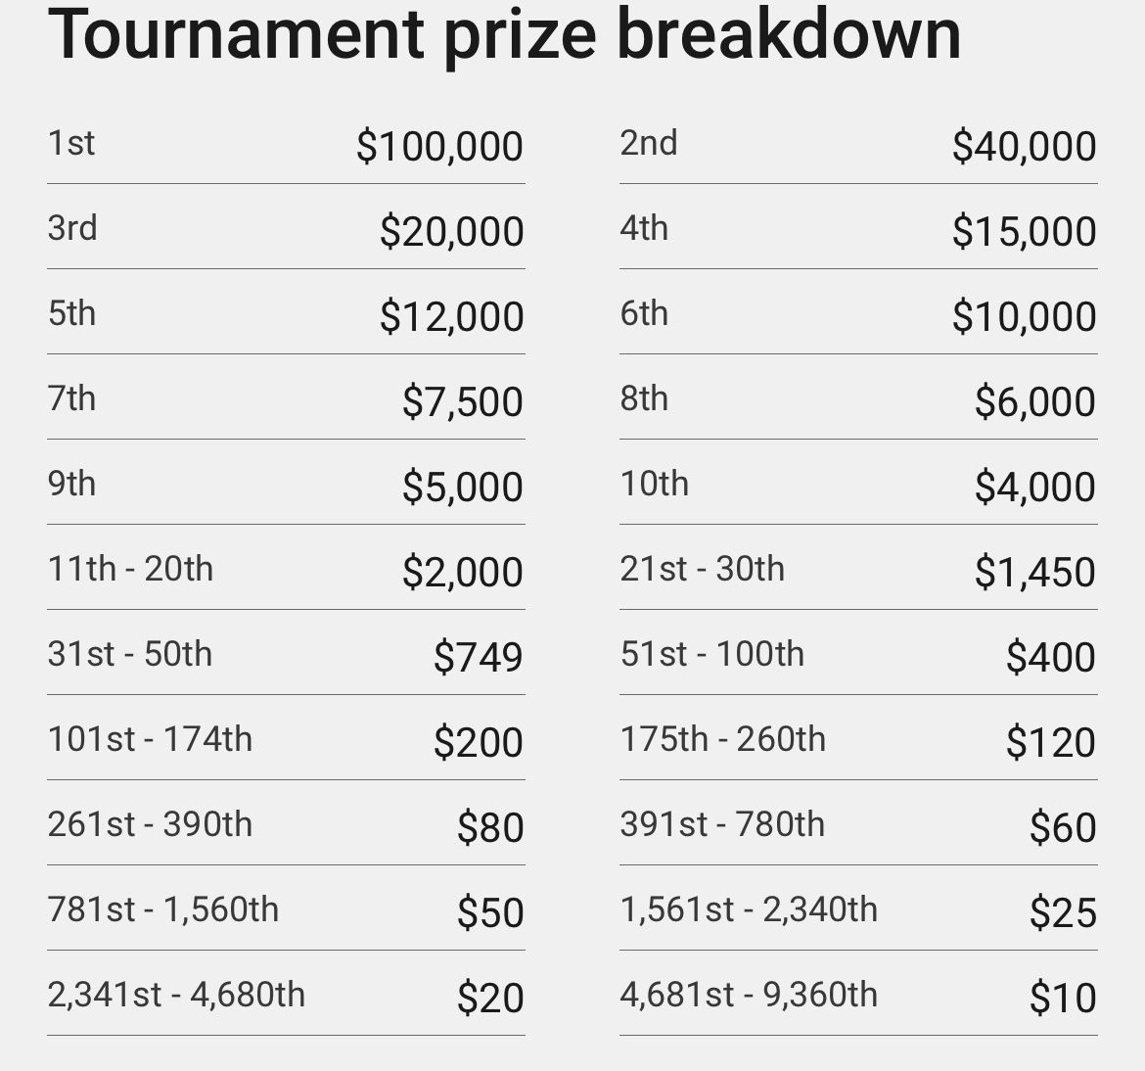
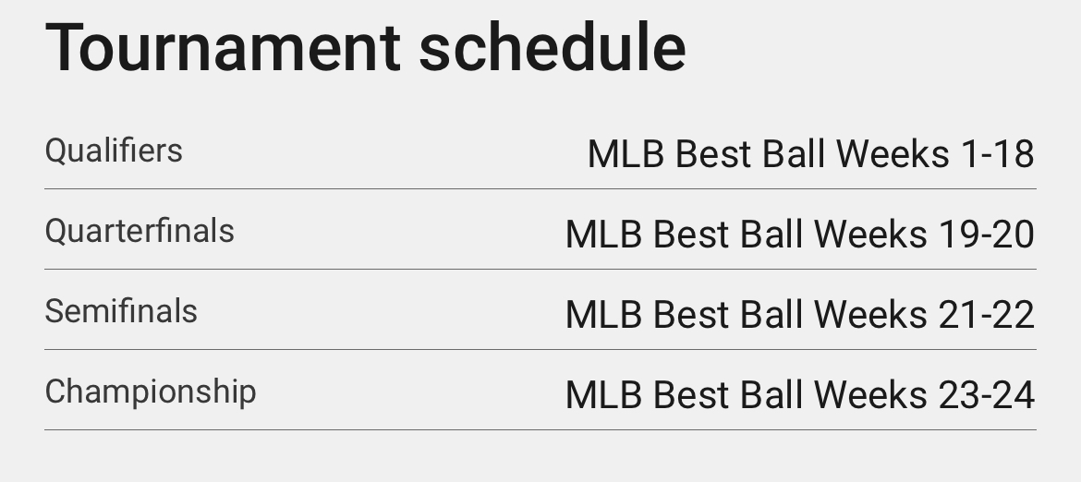
The Dinger Overview
Fantasy Baseball 'Best Ball' Tournament
54,ooo entrants, $10 entry fee
2/12 Teams advance in regular season groups
Same for 2 rounds of Playoffs
260 Team Finals
Extremely Top-Heavy Payout Strcuture

Slide 3
Research Question
Which roster construction was the most successful in the 2023 fantasy baseball season?
Used 2023 draft result data provided by Underdog Fantasy to analyze winning rosters
Analyzed successful position combinations
Looked at IF vs. OF scoring distributions
Success of stacking teammates
Data comes from Fangraphs, and draft result data provided by Underdog Fantasy
Used Python to analyze team constructions in regular season, playoffs, and final rounds

Slide 4
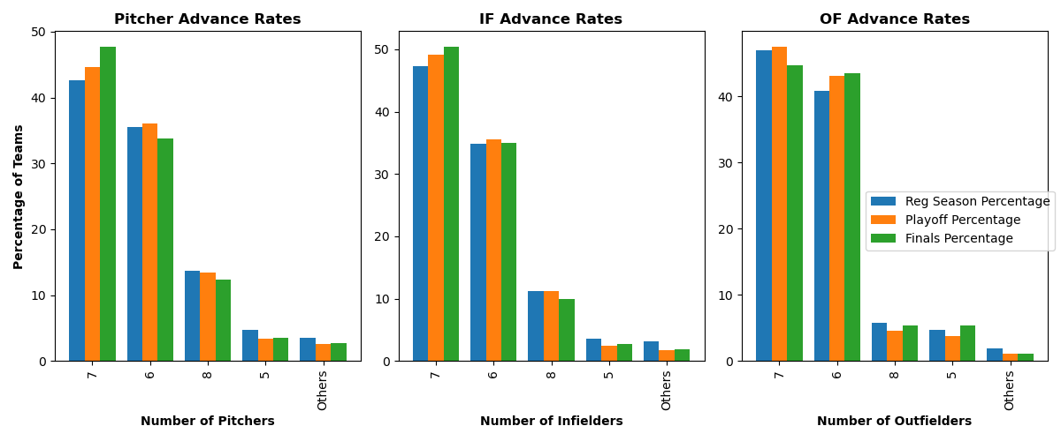
Roster Construction
Teams have 20 total players
Start 3 pitchers, 3 IF, 3 OF, and 1 Flex per week
Vast majority of teams stuck to 6 0r 7 players for each position
Sticking to this structure worked
7 Pitcher builds very effective
7 Infielders advanced at highest rate
6 OF highest advance rate

Slide 5
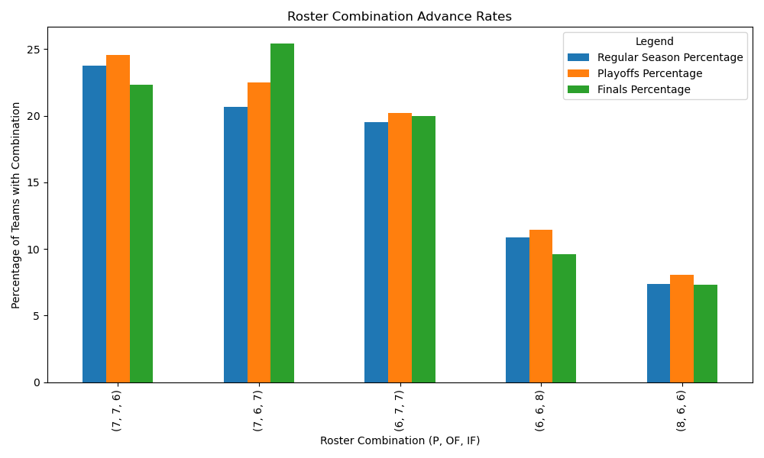
Roster Construction
7 P, 7 IF, 6 OF saw great results for finals advance rates
7 IF valuable given they score more points than OF
Sticking to "basic" builds again was most efficient style
Any combination of 6/7 P, IF, and OF resulted in playoff advance rates higher than expected

Slide 6
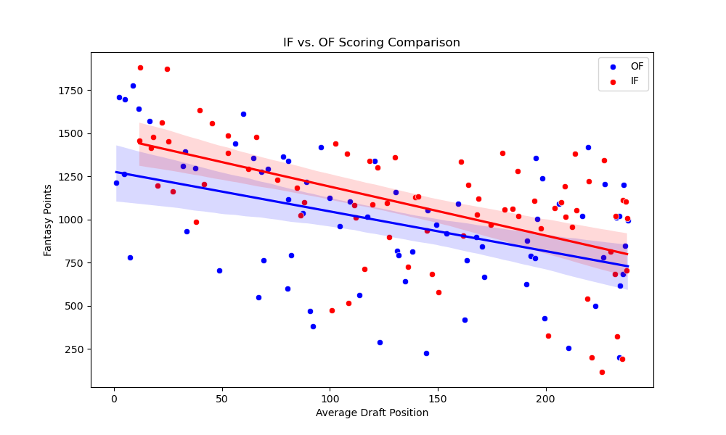
Infield vs. Outfield Scoring
Infielders scored more points than OF at every range of draft
Middle rounds saw high bust rates at OF
More position scarcity at OF
Need to start same amount, but want IF at Flex spot
Shows why 7 IF had high advance rates

Slide 7
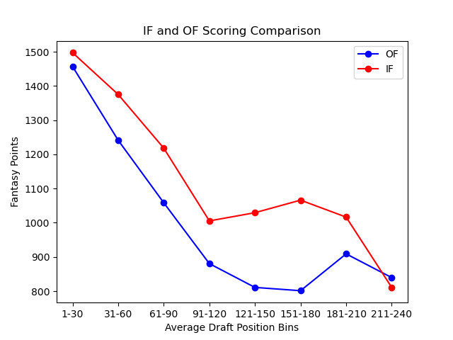
Infield vs. Outfield Scoring
When to draft IF/OF?
Grouped draft into 8 bins
Took Mean Points scored for OF/IF in each bin
IF scoring saw highest gap over OF in middle/late rounds
Likely when OF platoon bats are being drafted vs full time IF starters

Slide 8
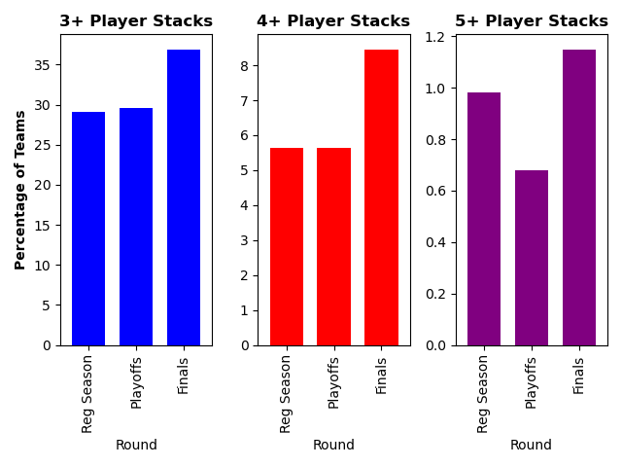
Stacking
Stacking is drafting players from same MLB team
Want to increase correlation with top heavy structure
About 30% of field stacked 3 players
Only 5% 4+ players
Less than 1% 5 players
Teams that stacked had higher chance of advancing to finals than field

Slide 9
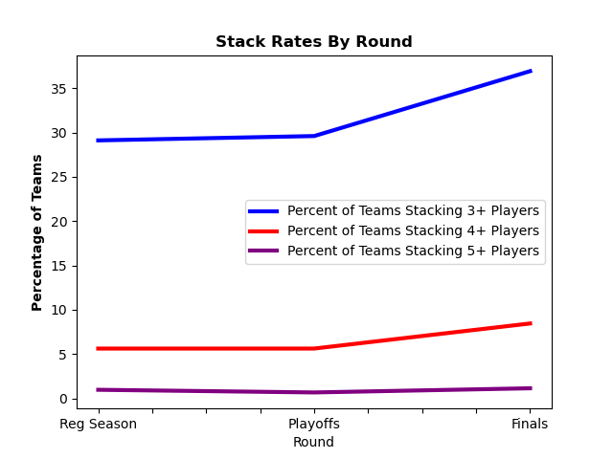
Stacking
3 and 4 player stacks saw neutral returns on playoff rate, but skyrocketed to finals
5 player stacks perhaps hurt floor (low playoff rate), but increased ceiling of teams
Clear benfits to stacking
With top heavy payout, want to be prioritizing correlation

Slide 10
Final Conclusions
The 7 Pitcher, 7 Infielder, 6 Outfielder build was the most effective in 2023
Some combination of 6 or 7 P, IF, and OF all saw good results
Did not need to get off the board with position combinatio n
Wanted to stack at least 3 players from same team to increase correlation
Stacking teams saw great finals advance rates
The optimal build for the 2023 season likely had 7 P, 7 IF, 6 OF, with infielders drafted heavily in mid/late rounds, and a 3+ player team stack

